Slide 1
AI ENCHANCED PLACECEMENT APP
VISHNU NAIR 2347131
ATHUL RAJA 2347108
3 MCA A

Slide 2


Introduction
The AI-Enhanced Placement App is a comprehensive web application designed to streamline the university placement process. It leverages artificial intelligence to provide students with personalized support in crafting resumes, applying for jobs, and receiving assistance through an AI chatbot. The administrative interface enables efficient management of student registrations, job postings, and application tracking.

Slide 3
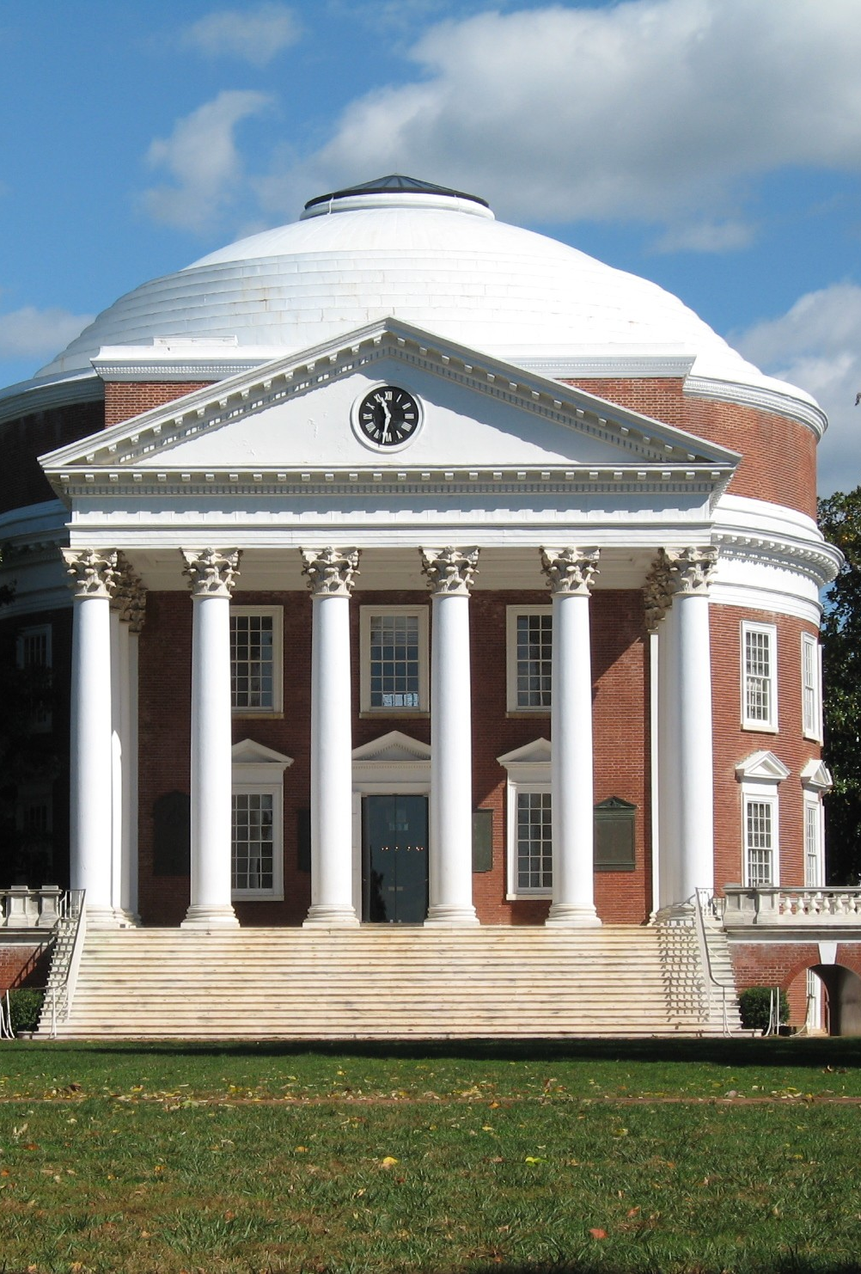
Need for the Project:
University placement processes often lack efficient organization and personalized support for students. This project addresses these challenges by offering a centralized platform with AI-driven features to enhance the placement experience for both students and administrators.
Inefficient Organization: Traditional placement lacks coordination, causing scattered postings and disjointed communication, leading to confusion for students and employers.
Lack of Personalized Support: Many students struggle with resumes and applications without guidance, hindering their ability to impress employers effectively.
Limited Access to Opportunities: Students miss out on placements due to unawareness, highlighting the need for a comprehensive job database.
Administrative Burden: Manual management is time-consuming, hindering efficient coordination and timely support for students.
This Photo by Unknown author is licensed under CC BY-SA.

Slide 4
Social Impact:
By facilitating smoother transitions from education to employment, the AI-Enhanced Placement App contributes to reducing unemployment rates among recent graduates. Additionally, it fosters a more meritocratic hiring process by empowering students with tools to present their skills effectively.
Reducing Unemployment Rates: The app streamlines education-to-employment transitions, connecting graduates with relevant job opportunities, thus curbing unemployment rates among recent graduates.
Empowering Students: Through features like AI-driven resume generation and personalized guidance, the app empowers students to effectively showcase their skills, promoting a merit-based hiring process and equal opportunities for all.

Slide 5

Alignment with SDGs:
Promoting Inclusive and Sustainable Economic Growth (SDG 8): The app aids smoother transitions into employment, boosting productivity and economic inclusivity by reducing graduate unemployment.
Full and Productive Employment (SDG 8): By matching graduates with suitable jobs, the app fosters full employment and maximizes workforce potential, enhancing productivity across various sectors.
Decent Work for All (SDG 8): Through merit-based opportunities, the app ensures equitable access to quality employment, promoting fair wages, safe conditions, and career advancement.
This Photo by Unknown author is licensed under CC BY-NC.

Slide 6

Existing Systems and Disadvantages:
Lack of personalized support for students in resume building and job applications: Existing systems often fail to provide tailored assistance to students, leaving them to navigate the complexities of resume creation and job applications on their own. This lack of personalized support hampers students' ability to highlight their unique skills and experiences effectively, resulting in generic resumes and missed opportunities for career advancement.
Inefficient management of job postings and application tracking: Current systems struggle to centralize job postings and track application progress efficiently. This fragmentation leads to difficulties in monitoring the status of applications, coordinating communication between students and employers, and ensuring timely updates on available opportunities. As a result, students may miss out on relevant job openings, while administrators face challenges in maintaining an organized and streamlined placement process.
This Photo by Unknown author is licensed under CC BY-SA-NC.

Slide 7
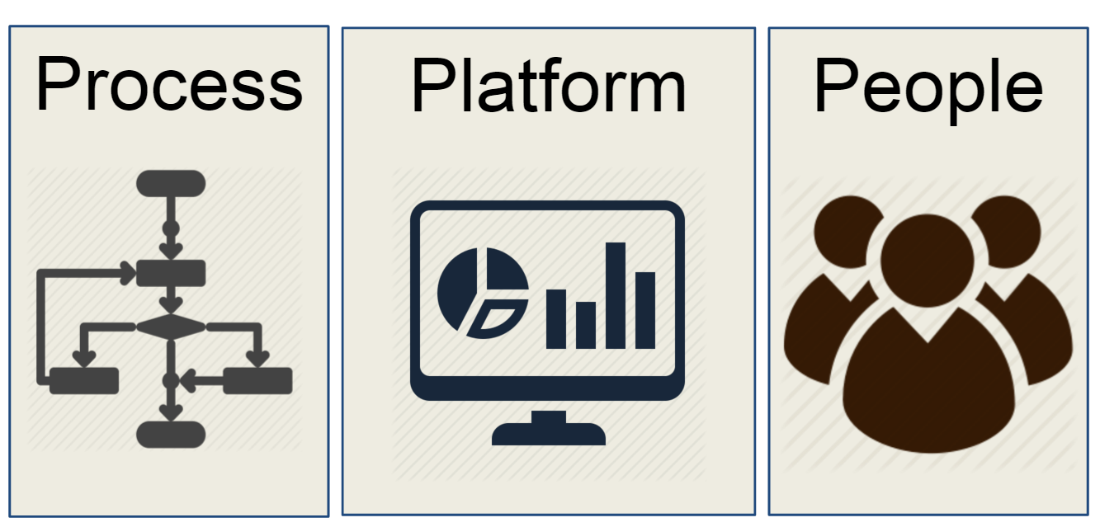
Proposed System and Advantages:
AI-driven resume generator: Personalized resume suggestions enhance student resumes, increasing chances of attracting employers.
Centralized platform: Simplifies job postings, application tracking, and communication for efficient placement management.
AI chatbot: Provides instant, personalized assistance to students, enhancing confidence and navigation of the placement process.
This Photo by Unknown author is licensed under CC BY-SA-NC.

Slide 8

Modules Description
Student Module:
Resume Generator: Allows students to create personalized resumes by inputting their education, skills, and experiences. The AI-driven generator suggests improvements and formats the resume professionally.
Job Application: Enables students to browse and apply for available job openings directly through the platform. Students can submit their resumes and cover letters seamlessly.
Notification System: Notifies students about new job postings, application updates, and any important announcements, ensuring they stay informed throughout the placement process.
AI Chatbot Support: Offers instant assistance to students by answering queries, providing guidance on resume building, job searching, and application procedures. The chatbot enhances user experience and addresses student concerns promptly.
This Photo by Unknown author is licensed under CC BY.

Slide 9

Modules Description
Admin Module:
Student Registration: Allows administrators to register students into the system, capturing essential details such as personal information, academic qualifications, and contact details.
Job Posting Management: Enables administrators to add, edit, and remove job postings, specifying details such as job title, description, requirements, and application deadlines.
HR Credential Creation: Facilitates the creation of credentials for HR personnel representing companies. Admins can assign roles and permissions to HR users, allowing them access to relevant features and data.
Application Tracking and Status Management: Provides administrators with tools to track the status of student applications, including stages like submission, review, shortlisting, and interview scheduling. Admins can update application statuses and communicate decisions to students efficiently.
This Photo by Unknown author is licensed under CC BY.

Slide 10
Limitations:
Limited integration with external job portals: The current system may have limited connectivity with external job portals, restricting the pool of job opportunities available to students. This limitation could potentially result in students missing out on relevant job openings beyond the platform's database.
Dependency on the accuracy and effectiveness of AI algorithms: The effectiveness of features like the resume generator, chatbot, and placement training relies heavily on the accuracy of AI algorithms. Inaccuracies or limitations in the algorithms could lead to suboptimal results, impacting the quality of resumes generated, the effectiveness of chatbot interactions, and the relevance of placement training.

Slide 11
Future Enhancements:
Expanded integration with external job portals: Enhancing integration with external job portals would broaden the scope of job opportunities available to students, providing them with access to a more extensive range of career options across various industries and companies.
Improvement of AI algorithms: Continuous refinement and enhancement of AI algorithms powering the resume generator, chatbot functionalities, and placement training would ensure greater accuracy, effectiveness, and reliability. This improvement would enhance the overall user experience and provide students with more valuable and personalized support throughout the placement process.

Slide 12
Conclusions
The AI-Enhanced Placement App revolutionizes the university placement process by harnessing the power of artificial intelligence to provide personalized support and efficient management. It not only benefits students by facilitating their transition into the workforce but also streamlines administrative tasks for universities and employers.

Slide 13
Project Publication Details
Acceptance for Presentation
We are pleased to announce that your paper has been accepted for presentation at the International Conference on Engineering Advancements and Sustainable Development, to be held on April 29th & 30th.

Slide 14
Thank you

